Slide 1


INTRODUCTION TO GENERATIVE AI

Slide 2
MODULE AGENDA

Slide 3

Module Agenda
What is AI and Generative AI?
What is ChatGPT?
What is Microsoft CoPilot?
AI History & Future
Popular AI Models & Top Generative AI Tools
Demo 1: Exploring ChatGPT, Claude, Gemini, & Deepseek
Demo 2: Exploring ChatGPT Tools
Demo 3: Exploring Microsoft 365 CoPilot
Practice Opportunity
© All rights reserved for Dr. Ryan Ahmed @Stemplicity Inc.

Slide 4
WHAT IS AI & GENERATIVE AI?

Slide 5
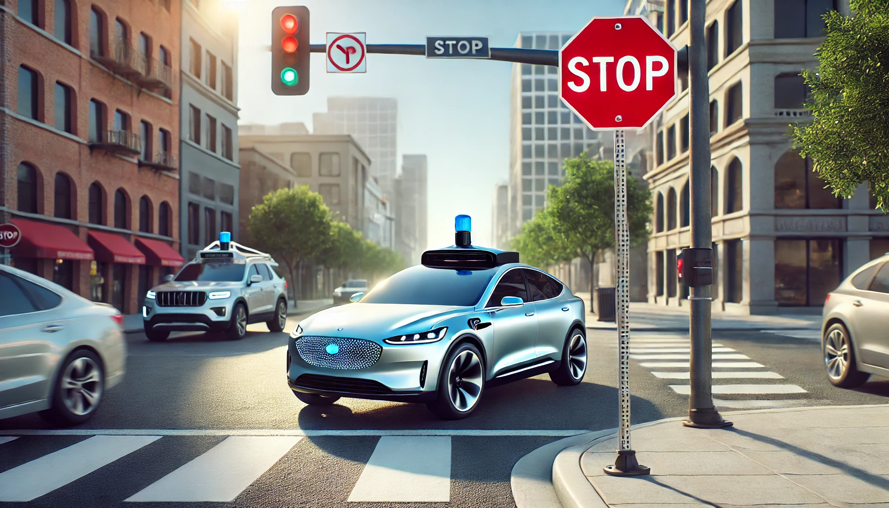
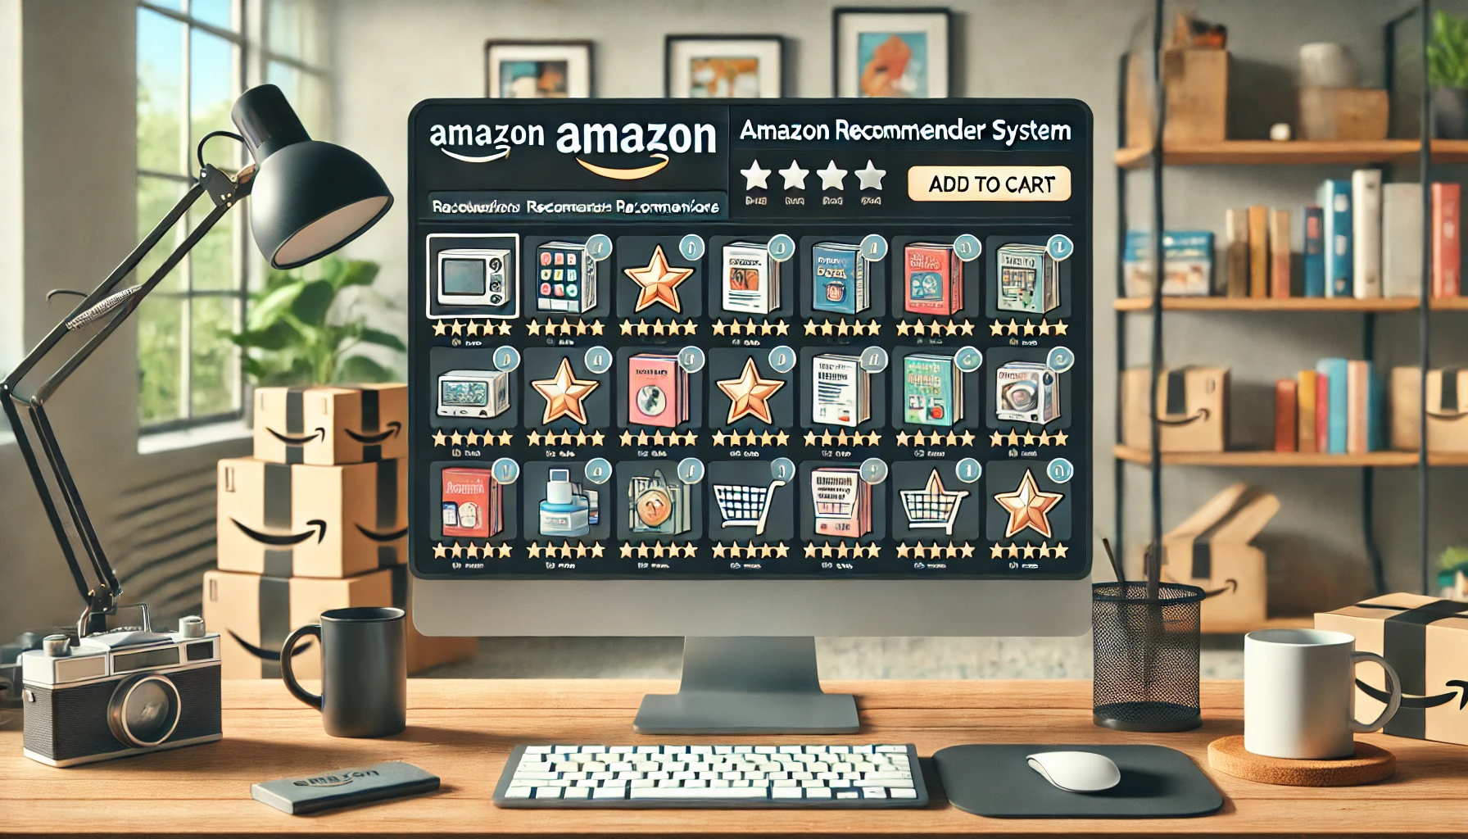
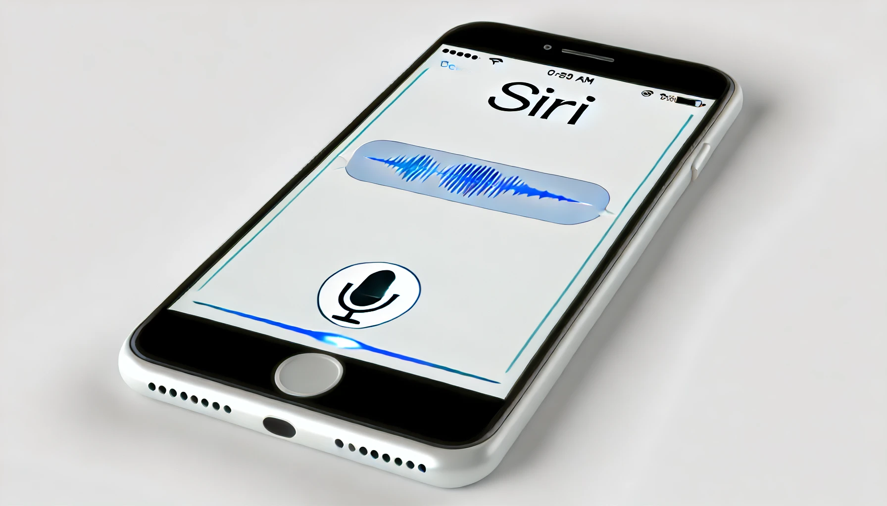
What is Artificial Intelligence (AI)?
Artificial intelligence (AI) is the science that empowers machines to learn from experience, make decisions, and perform human-like tasks.
AI does not only mean robots or Sci-Fi movies! AI applications are everywhere.
Can You Think of 3 AI Applications That You Encountered Today?
© All rights reserved for Dr. Ryan Ahmed @Stemplicity Inc.

Slide 6

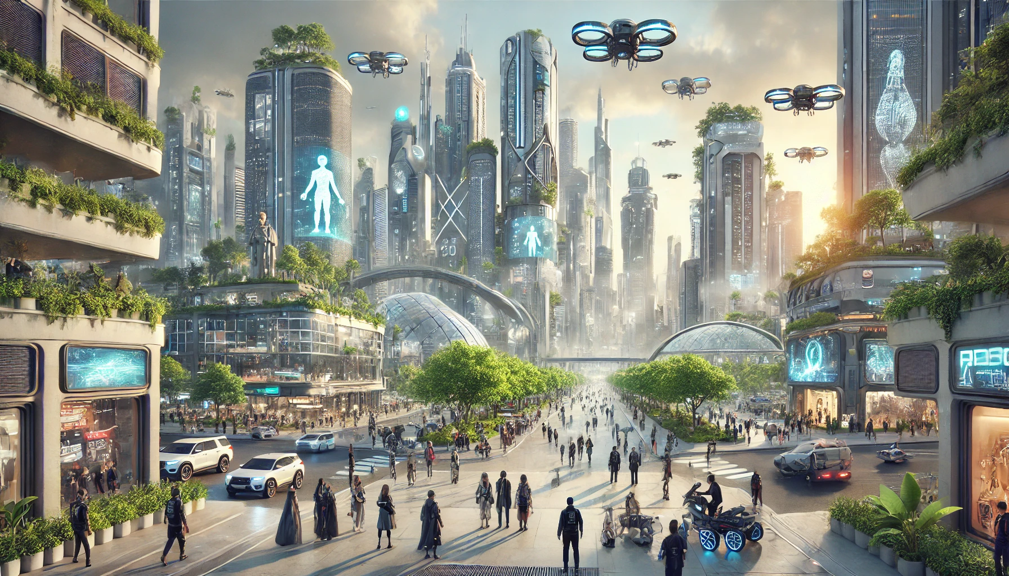
What is Generative AI?
Generative AI is a subset of AI that can create new content such as text, images, music, and videos.
Unlike traditional AI, which is primarily focused on recognizing patterns or making decisions, generative AI produces novel outputs that closely resemble the examples it was trained on.
Model Output
User Prompt:
Generate an image of a city in the year 2500
© All rights reserved for Dr. Ryan Ahmed @Stemplicity Inc.
Generative AI model

Slide 7
WHAT IS CHATGPT & COPILOT?

Slide 8
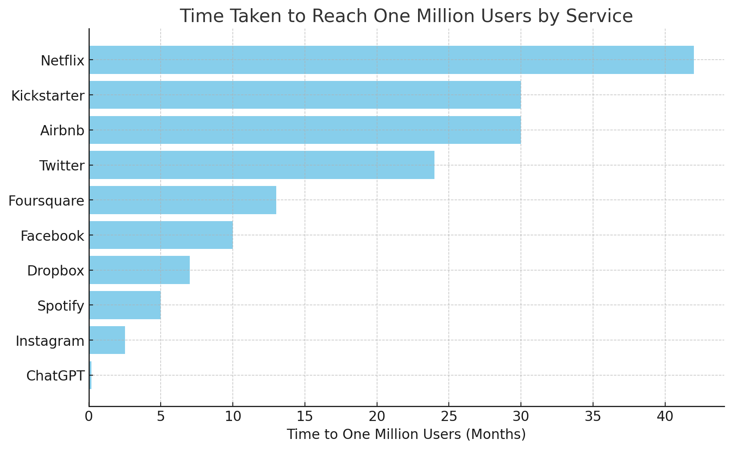
What is ChatGPT?
ChatGPT is a popular generative AI model developed by OpenAI.
It became one of the fastest-growing applications in history, reaching 1M users in 5 days.
Answer Questions
Generate Creative Content
Language Assistance
Data Analysis
Code Assistance
© All rights reserved for Dr. Ryan Ahmed @Stemplicity Inc.

Slide 9
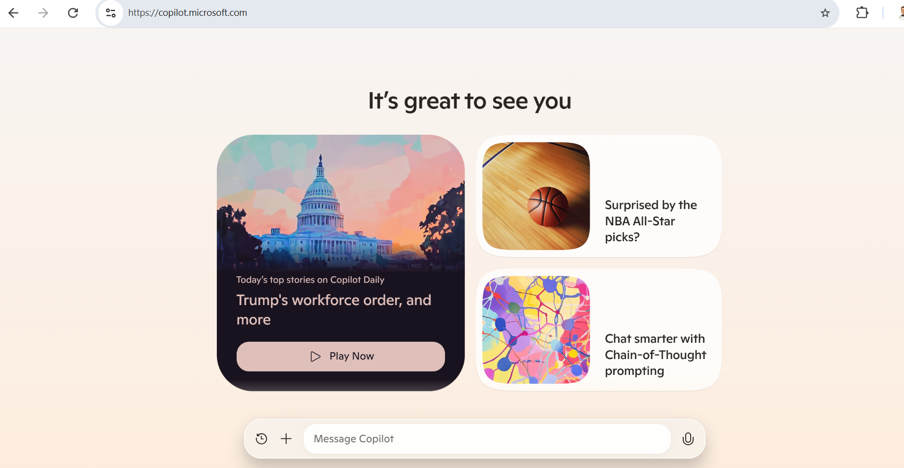

What is Microsoft CoPilot?
Microsoft Copilot is an AI-powered assistant designed to help you with a wide range of tasks.
It leverages advanced AI models, like GPT-4, to provide support in various areas such as productivity, information synthesis, and more.
Link: https://copilot.microsoft.com/
© All rights reserved for Dr. Ryan Ahmed @Stemplicity Inc.

Slide 10
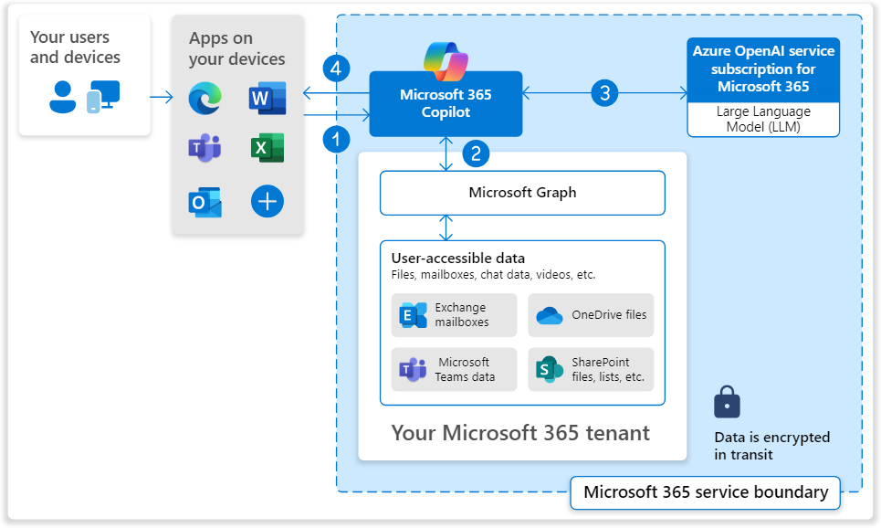
What is Microsoft 365 CoPilot?
Microsoft 365 Copilot is an AI-powered productivity tool that has real-time access to both your content and context in the Microsoft Graph.
This means it generates answers anchored in your business content — your documents, emails, calendar, chats, meetings, contacts and other business data
User inputs a prompt in Copilot
Copilot preprocesses the prompt using grounding, enhancing relevance.
Grounded prompt is sent to the LLM, which generates a contextually relevant response.
Copilot delivers the response back to the user.
© All rights reserved for Dr. Ryan Ahmed @Stemplicity Inc.
Source: https://learn.microsoft.com/en-us/copilot/microsoft-365/microsoft-365-copilot-architecture

Slide 11
AI HISTORY & FUTURE

Slide 12
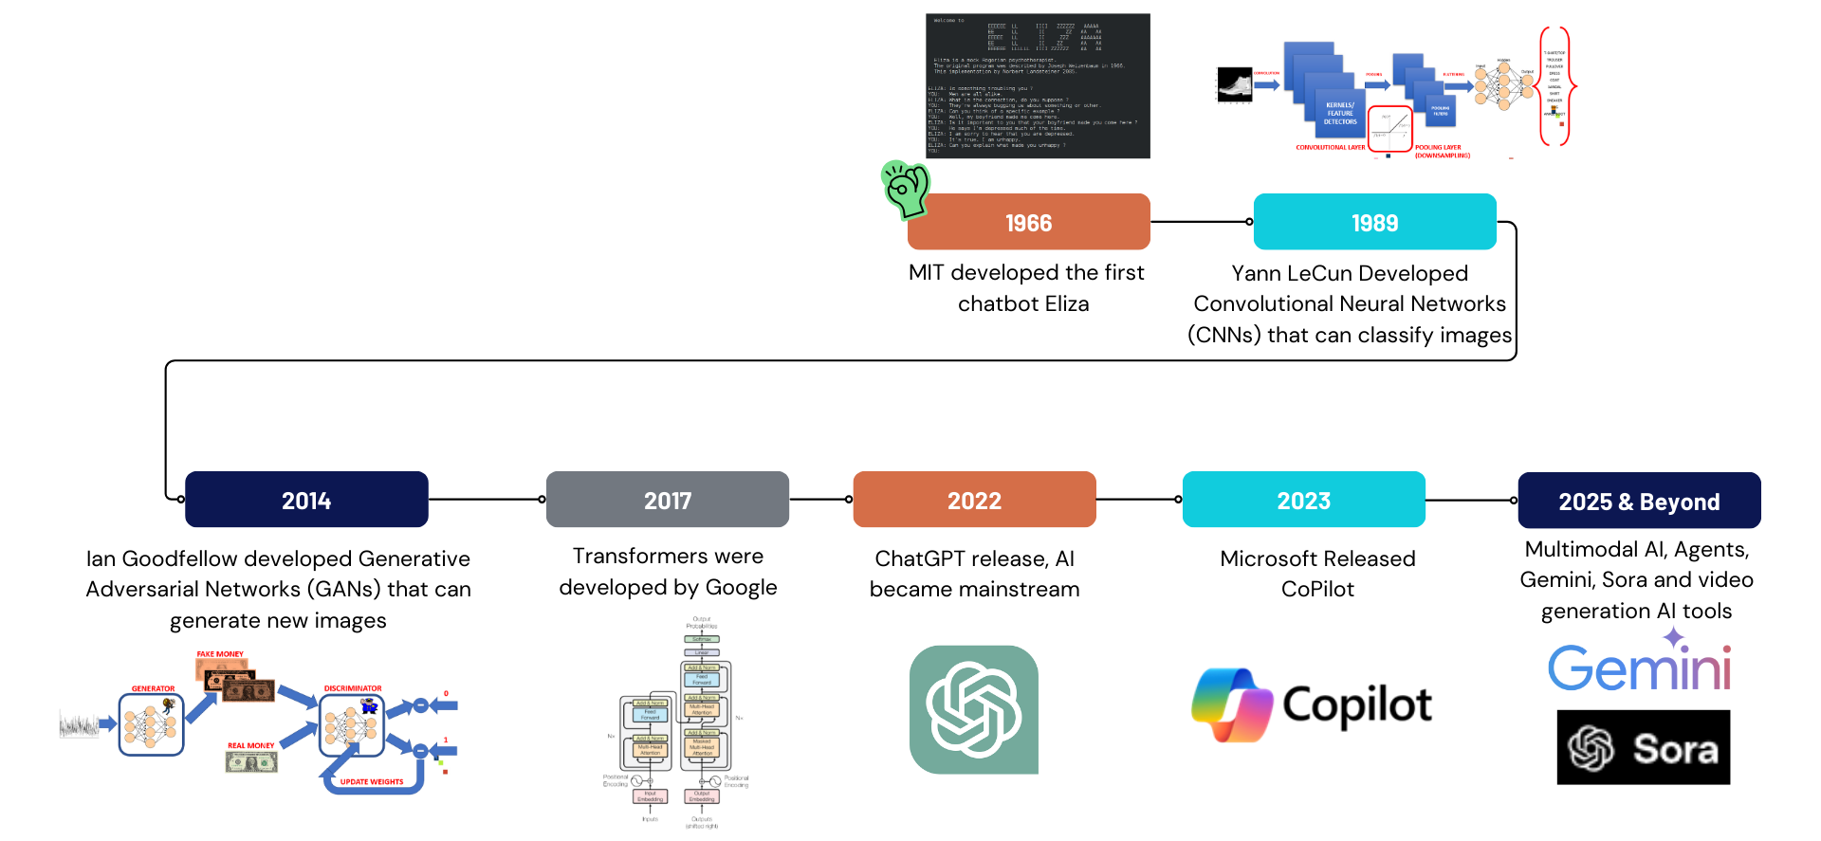
AI History
© All rights reserved for Dr. Ryan Ahmed @Stemplicity Inc.

Slide 13
Future of Artificial General Intelligence (AGI)
Level 1: Conversational AI
AI that interacts in conversational language with people. Ex: ChatGPT & Claude
Level 2: Reasoning AI
Performs basic problem-solving tasks comparable to a PhD-level human but without access to any tools.
Level 3: Autonomous AI
AI “agents” that can operate autonomously on a user’s behalf.
Level 4: Innovating AI
AI systems that develop innovations independently. Not just running processes but improving them.
Level 5: Organizational AI
Final stage of super AI that performs the work of an organization. Functions are carried out by agents that make improvements without humans.
AGI is a type of AI that can outperform humans on most tasks.
OpenAI predicts to achieve level 5 in 10 years or less.
© All rights reserved for Dr. Ryan Ahmed @Stemplicity Inc.

Slide 14
Intelligence Beyond AGI
Aspect | ANI (Artificial Narrow Intelligence) | AGI (Artificial General Intelligence) | ASI (Artificial Superintelligence)
Stage | Today | To Come | Post-AGI
Feature Description | Executes specific tasks; cannot generalize to other tasks. | Performs broad tasks, reasons, and improves capabilities comparable to humans. | Demonstrates intelligence beyond human capabilities.
Capabilities | Limited to specific, pre-defined functions (e.g., driving, diagnosing). | Can learn new tasks and reason like a human. | Surpasses human intelligence, making decisions beyond human reasoning.
Examples | Virtual assistants, recommendation systems, autonomous vehicles. | Hypothetical at present; able to pass the Turing Test and perform any intellectual task. | Hypothetical; could innovate independently or tackle complex global issues.
Impact | Outperforms humans in repetitive, specific tasks. | Competes with humans across all intellectual domains. | Superior to humans, capable of solving or threatening societal goals.
Potential Risks | Minimal, as its functions are narrow and controlled. | Medium, depending on its alignment with human values. | High, as its superintelligence could surpass human control.
© All rights reserved for Dr. Ryan Ahmed @Stemplicity Inc.

Slide 15
POPULAR AI MODELS & TOP GENERATIVE AI TOOLS

Slide 16




Popular AI Models
 | GPT-4.o | Google Gemini | LLaMA (Meta AI) | Claude (Anthropic)
Pros | Excellent human language comprehension, ideal for general-purpose AI applications (e.g., Copilot) | Strong integration with Google services & excels in search | Open-source and high flexibility | Prioritizes ethical considerations and AI safety
 | Fine-tuning capabilities for customization | Multi-modal capabilities (text, image, video) | High customizability | Prioritizes human value alignment
Cons | High cost and resource-intensive | Low performance compared to GPT-4.o | Less versatile and potential security risks | Smaller market presence and limited options
© All rights reserved for Dr. Ryan Ahmed @Stemplicity Inc.

Slide 17
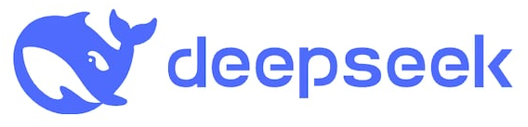
Popular AI Models: Deepseek
China's newly launched DeepSeek AI chatbot has sent shockwaves through the tech industry.
It rapidly surpassed OpenAI's ChatGPT to become the most downloaded free iOS app in the US.
It contributed to a $600 billion drop in Nvidia's market value in a single day—the largest decline in US stock market history.
The AI that powers Deepseek has reasoning capabilities comparable to US models such as OpenAI’s ChatGPT but requires a fraction of the cost to train and run ($6M vs. ~100M for GPT-4).
© All rights reserved for Dr. Ryan Ahmed @Stemplicity Inc.

Slide 18



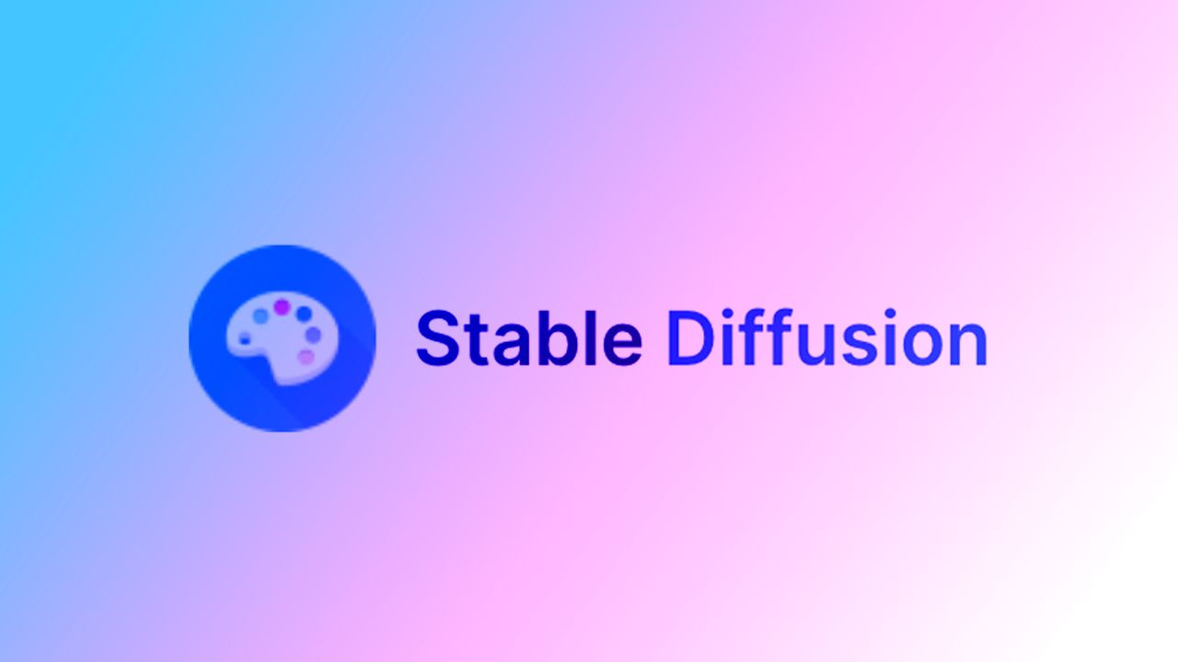


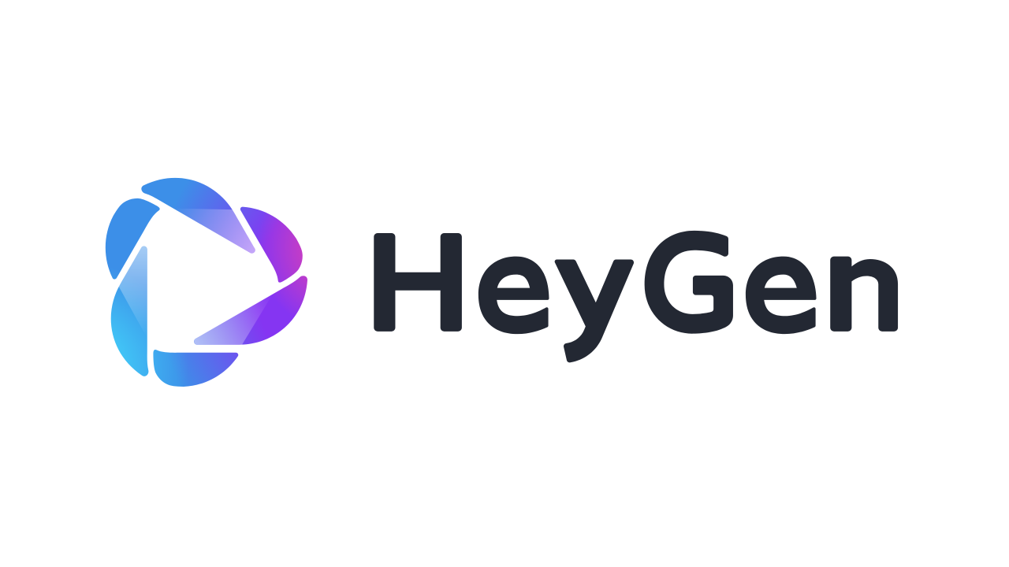
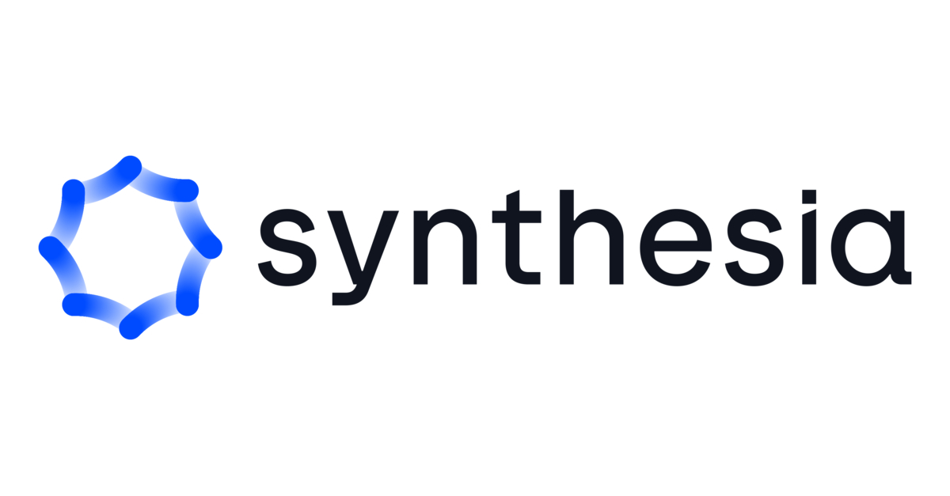

Top Generative AI Tools
GENERAL MULTIMODAL CHATBOTS
IMAGE GENERATION AI TOOLS
© All rights reserved for Dr. Ryan Ahmed @Stemplicity Inc.
AI AVATARS

Slide 19
DEMO 1: CHATGPT, GEMINI, CLAUDE, & DEEPSEEK

Slide 20
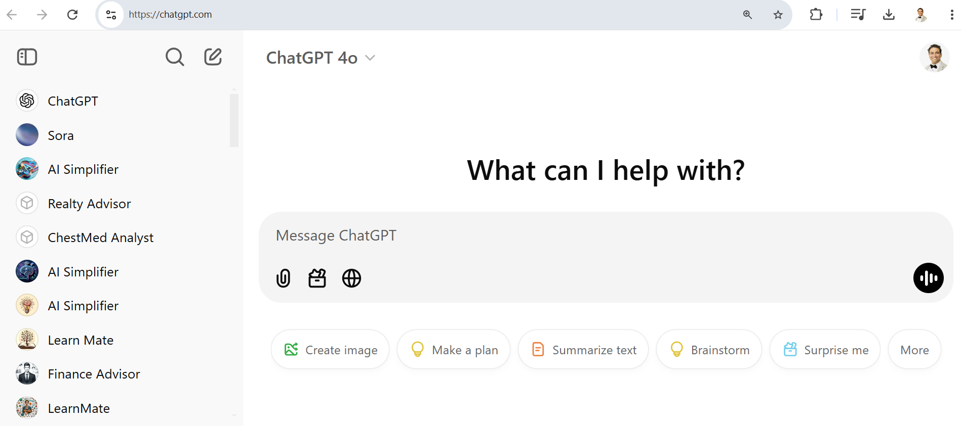
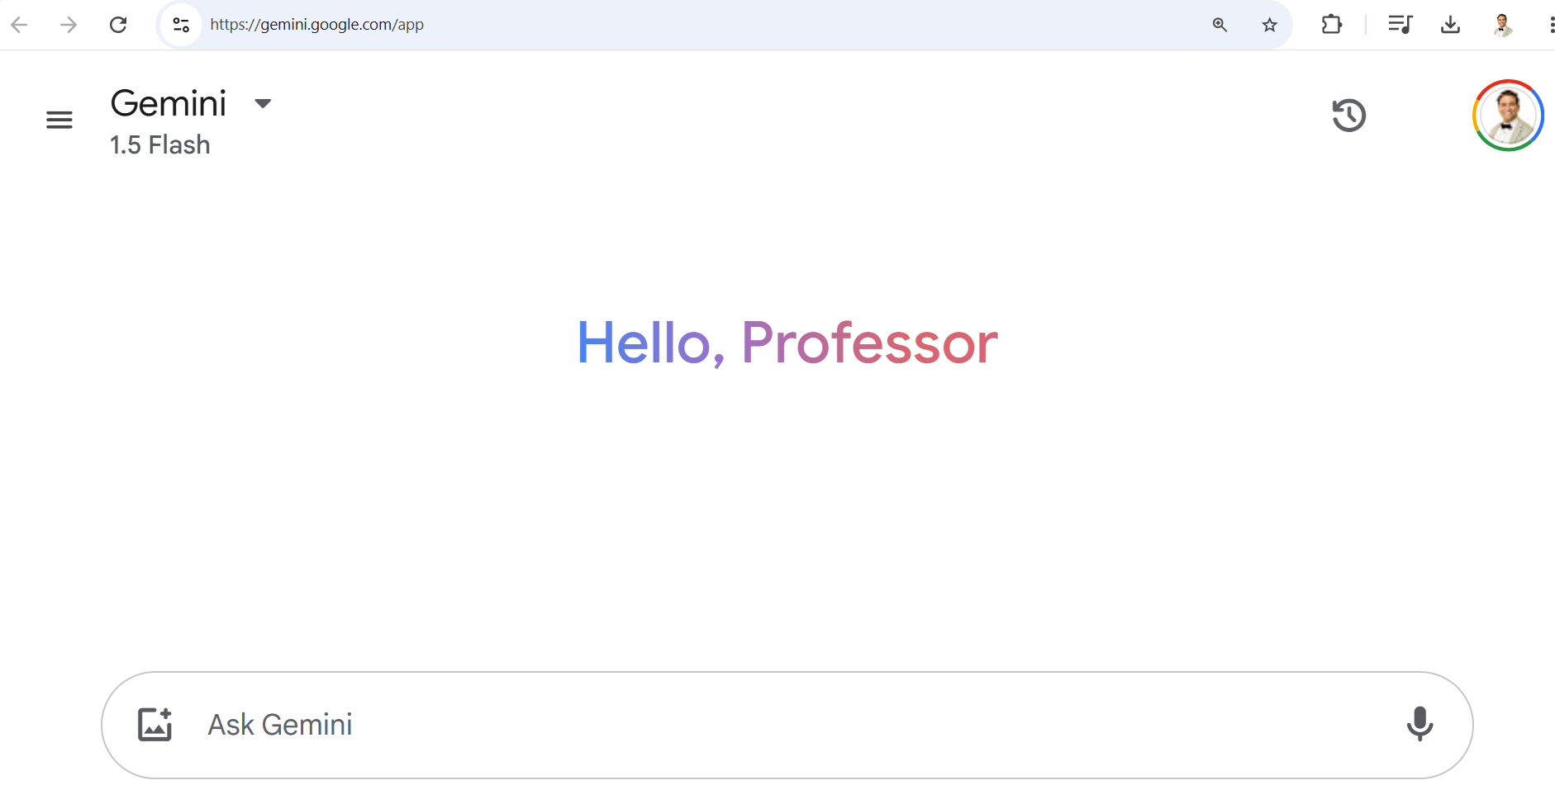
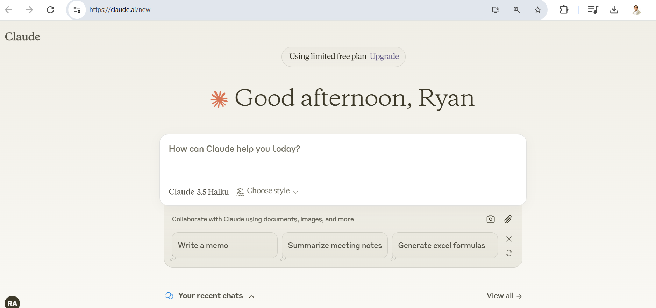
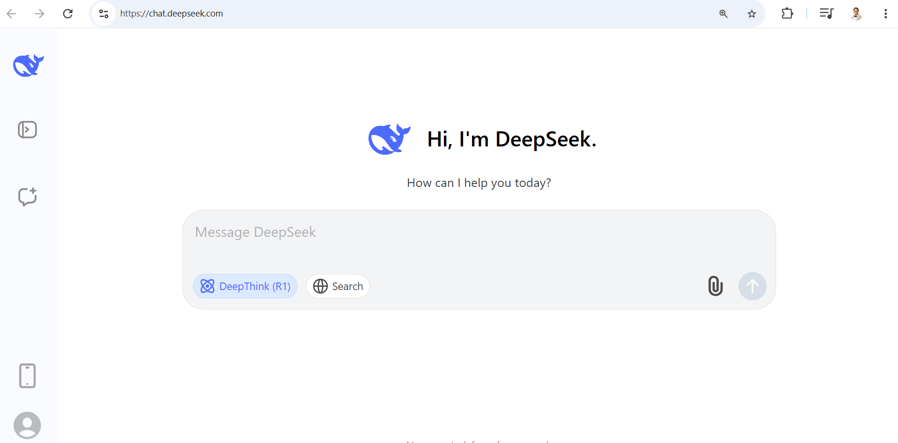
ChatGPT, Gemini, Claude, & DeepSeek Demo
🔗 Click here to explore ChatGPT ChatGPT Signup
🔗 Click here to explore Google Gemini Gemini Signup
🔗 Click here to explore Claude Claude Signup
🔗 Click here to explore Deepseek Deepseek Signup
💡 Click here for AI Prompts Explore Prompts
© All rights reserved for Dr. Ryan Ahmed @Stemplicity Inc.

Slide 21
DEMO 2: CHATGPT TOOLS

Slide 22
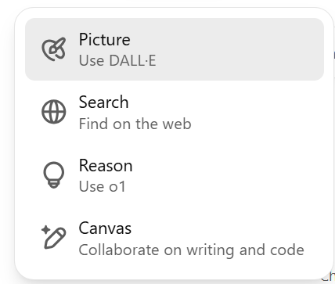
ChatGPT Tools
Picture – Use DALL·E:
Generate images based on a text description.
DALL·E is an AI model that creates images from prompts.
Search – Find on the web:
Search the internet for up-to-date information.
Gets information not included in ChatGPT's knowledge base.
Reason – Use o1:
Perform advanced reasoning, such as solving complex problems.
Useful for critical thinking, math, or multi-step reasoning.
Canvas – Collaborate on writing/code:
Work collaboratively on documents or code in real time.
Create and edit essays, reports, or code snippets.
© All rights reserved for Dr. Ryan Ahmed @Stemplicity Inc.

Slide 23
ChatGPT Tools Demo
🔗 Click here to explore ChatGPT ChatGPT Signup
💡 Click here for AI Prompts Explore Prompts
© All rights reserved for Dr. Ryan Ahmed @Stemplicity Inc.

Slide 24
DEMO 3: MICROSOFT COPILOT DEMO

Slide 25
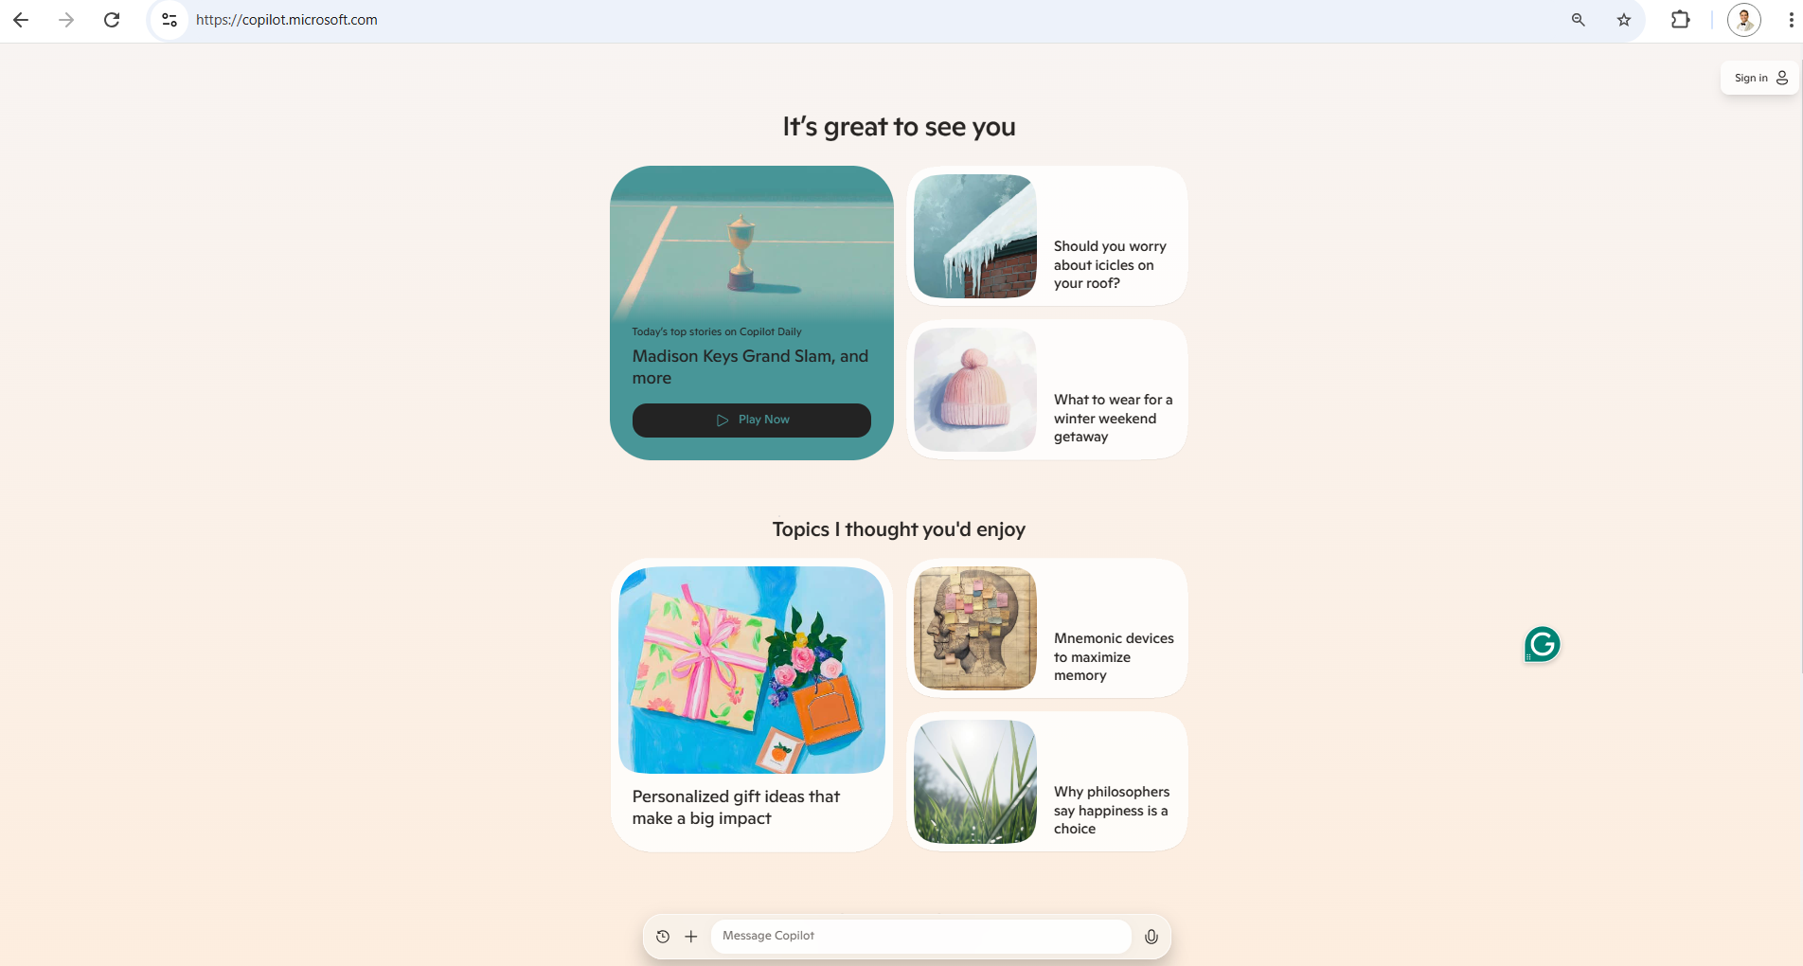
CoPilot Demo
🔗 Click here to explore CoPilot CoPilot Signup
💡 Click here for AI Prompts Explore Prompts
© All rights reserved for Dr. Ryan Ahmed @Stemplicity Inc.

Slide 26
Practice Opportunity

Slide 27

Practice Opportunity
Objective: Test GenAI models' capabilities in extracting relevant insights from unstructured data.
Scenario: You have received customer reviews about 2 popular products: "EcoBottle" (a reusable water bottle) and "HydraTherm" (a temperature-regulating bottle). The data is available in the “product_reviews.csv” file. You want insights into: (1) Reviews sentiment, (2) Key feature discussed in each review (features users love and common complaints), and (#3) Suggestions for improvement
Tasks:
Task 1: Using GPT-4.o, select a sample review from the “product_reviews.csv” and write the appropriate prompt to classify it as positive, negative or neutral.
Task 2: Extract the key feature discussed in the review you chose in Task 1.
Task 3: Perform similar analysis on all reviews
Task 4: Export the results in a new Excel file named “product_reviews_GPT4_sentiment.csv”.
Task 5: Evaluate how effectively the model identifies patterns from the reviews. Compare the results to “product_reviews_solution.csv”.
Task 6: Suggest 3 recommendations to executive leadership to address customer complaints.
© All rights reserved for Dr. Ryan Ahmed @Stemplicity Inc.

Slide 28
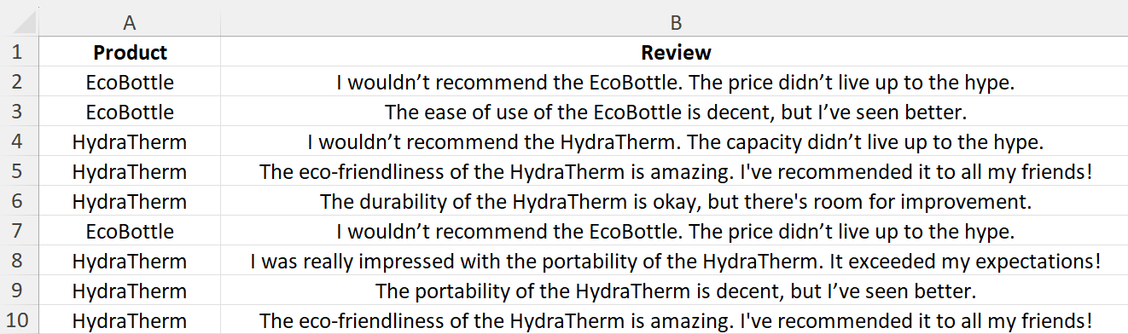
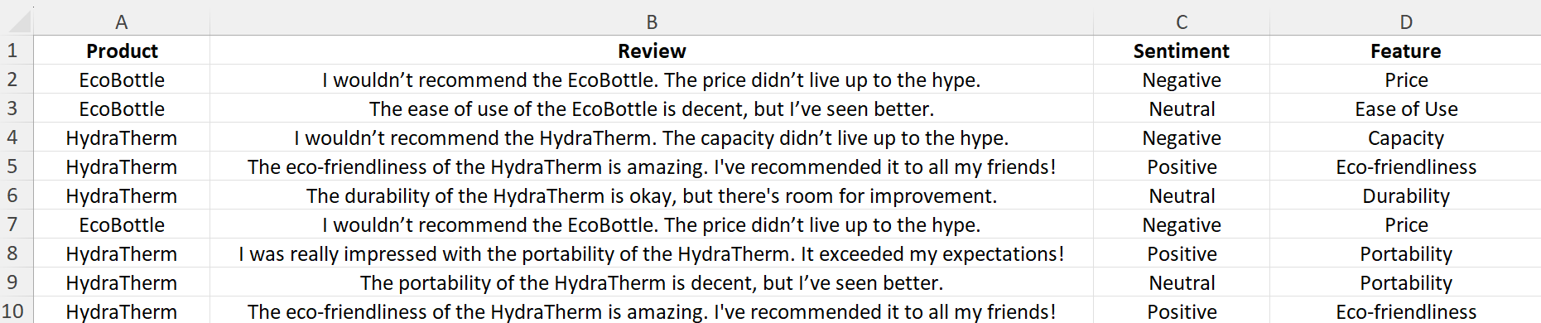
Sample Datasets and Expected Output
Dataset provided in the “product_reviews.csv” file included in the course package.
MODEL INPUT DATA
© All rights reserved for Dr. Ryan Ahmed @Stemplicity Inc.
NEWLY ADDED COLUMNS
MODEL GENERATED OUTPUT

Slide 29
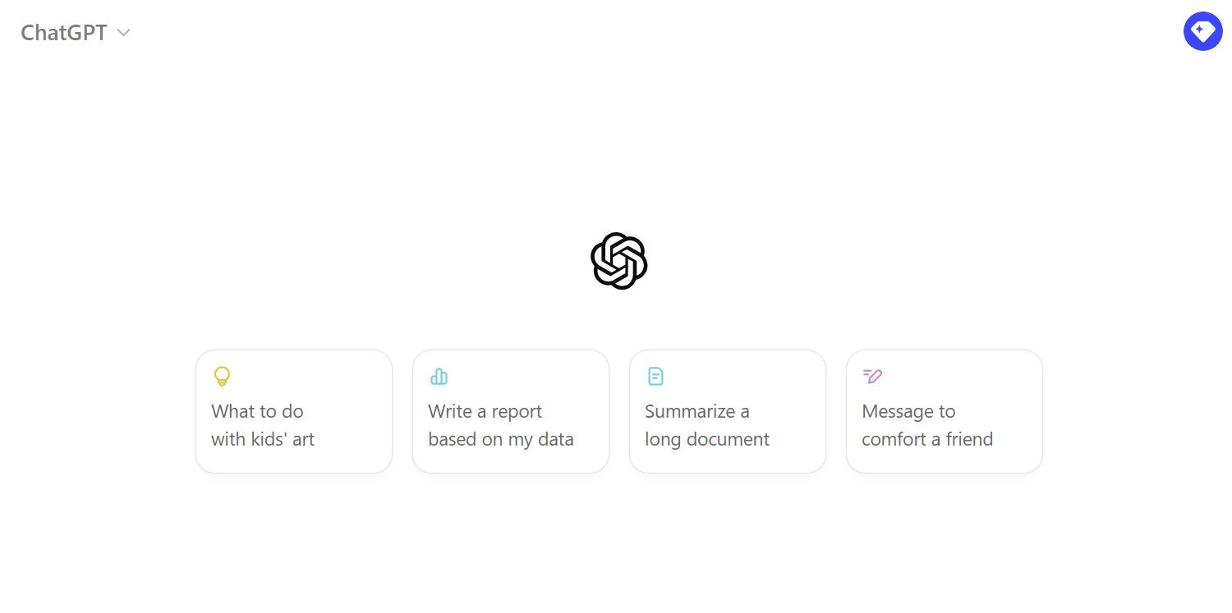
Practice Opportunity Solutions
🔗 Click here to explore ChatGPT ChatGPT Signup
💡 Click here for AI Prompts Explore Prompts
💡 Click here for Practice Opportunities Solution Explore Prompts
© All rights reserved for Dr. Ryan Ahmed @Stemplicity Inc.

Slide 30
Thank you!

